Slide 1
AJL Energy
Michael Le

Slide 2
Requirements
Files and Sources: Main-Stuff/DA Bootcamp 2026 Emergi Mentors/Week 2 SQL Mastery/Module 3 Intermediate SQL for Analytics Professionals/AJL_Energy_Subqueries at main · Mikele02171/Main-Stuff
Microsoft SQL Server Express (2022 or (2025 preferred))

Slide 3

Content
Create Database AJL Energy
DDL: Creating Customers and Monthly Usage Tables
DML: Insert customers, monthly usage
DQL: Validation
DQL: Average kwh (Not ideal!)
DQL: Customers using more than overall average
DQL: Customers using more than THEIR STATE average
DQL: Showing customer usage vs state avg vs state max
DQL: Showing states with average usage > 600 kWh
DQL: Find Customers who HAVE high usage (>1500 kWh)
DML and DQL: Find Customers with NO Usage records
DQL: Find Customers whose usage is BELOW their state average
DQL: Find the top 3 highest usage customers in each state
DQL: Find Customers who have NO usage records at all
DQL: Create state summary, then filter to average usage (> 600)
DQL: Find customers whose bill is >150% of their state average bill

Slide 4
Create Database for AJL Energy
USE master;
GO
-- Drop database if exists (fresh start)
IF EXISTS (SELECT name FROM sys.databases WHERE name = 'AJL_Energy')
BEGIN
PRINT 'Dropping existing AJL_Energy database...';
ALTER DATABASE AJL_Energy SET SINGLE_USER WITH ROLLBACK IMMEDIATE;
DROP DATABASE AJL_Energy;
PRINT '✅ Existing database dropped successfully';
END
GO
-- Create fresh database
CREATE DATABASE AJL_Energy;
GO
USE AJL_Energy;
GO

Slide 5
DDL: Creating Customers and Monthly Usage Tables
-- Customer information table
CREATE TABLE customers (
customer_id INT PRIMARY KEY,
customer_name NVARCHAR(100),
state NVARCHAR(10),
suburb NVARCHAR(50),
account_type NVARCHAR(20),
signup_date DATE
);
-- Monthly electricity usage table
CREATE TABLE monthly_usage (
usage_id INT PRIMARY KEY,
customer_id INT FOREIGN KEY REFERENCES customers(customer_id),
usage_month DATE,
kwh_used DECIMAL(10,2),
bill_amount DECIMAL(10,2)
);
PRINT '=== Tables Created: customers, monthly_usage ===';
GO

Slide 6
DML: Insert customers, monthly usage Part 1
INSERT INTO customers VALUES
-- NSW customers (cooler climate, moderate usage ~450 kWh average)
(1001, 'Sarah Mitchell', 'NSW', 'Bondi', 'Residential', '2022-01-15'),
(1002, 'James Chen', 'NSW', 'Parramatta', 'Residential', '2021-08-20'),
(1003, 'Emma Thompson', 'NSW', 'Newcastle', 'Residential', '2023-03-10'),
(1004, 'Liam O''Connor', 'NSW', 'Manly', 'Residential', '2022-11-05'),
(1005, 'Olivia Patel', 'NSW', 'Penrith', 'Residential', '2021-05-22'),
(1016, 'Benjamin Kim', 'NSW', 'Sydney CBD', 'Residential', '2023-02-14'),
(1019, 'Alexander Liu', 'NSW', 'Wollongong', 'Residential', '2023-05-30'),
-- VIC customers (cooler climate, winter heating ~520 kWh average)
(1006, 'William Zhang', 'VIC', 'Melbourne CBD', 'Residential', '2022-07-14'),
(1007, 'Ava Nguyen', 'VIC', 'Carlton', 'Residential', '2021-12-01'),
(1008, 'Noah Williams', 'VIC', 'Brunswick', 'Residential', '2023-04-18'),
(1009, 'Isabella Brown', 'VIC', 'St Kilda', 'Residential', '2022-09-25'),
(1010, 'Mason Taylor', 'VIC', 'Richmond', 'Residential', '2021-06-30'),
(1017, 'Harper Singh', 'VIC', 'Geelong', 'Residential', '2022-10-20'),
(1020, 'Mia Johnson', 'VIC', 'Ballarat', 'Residential', '2022-12-15'),
-- QLD customers (hot climate, heavy aircon usage ~680 kWh average)
(1011, 'Sophia Anderson', 'QLD', 'Brisbane CBD', 'Residential', '2022-02-10'),
(1012, 'Lucas Martin', 'QLD', 'Surfers Paradise', 'Residential', '2021-09-15'),
(1013, 'Charlotte Garcia', 'QLD', 'Cairns', 'Residential', '2023-01-20'),
(1014, 'Ethan Rodriguez', 'QLD', 'Townsville', 'Residential', '2022-06-08'),
(1015, 'Amelia Lee', 'QLD', 'Gold Coast', 'Residential', '2021-11-12'),
(1018, 'Evelyn Tran', 'QLD', 'Sunshine Coast', 'Residential', '2021-07-25');

Slide 7
DML: Insert customers, monthly usage Part 2
INSERT INTO monthly_usage VALUES
-- NSW customers (average ~450 kWh, moderate)
(2001, 1001, '2024-12-01', 420.50, 168.20),
(2002, 1002, '2024-12-01', 480.00, 192.00),
(2003, 1003, '2024-12-01', 1850.00, 740.00), -- OUTLIER! 311% over NSW avg (Faulty heater?)
(2004, 1004, '2024-12-01', 390.20, 156.08),
(2005, 1005, '2024-12-01', 510.00, 204.00),
(2016, 1016, '2024-12-01', 445.00, 178.00),
(2019, 1019, '2024-12-01', 1620.00, 648.00), -- OUTLIER! 260% over NSW avg (Pool pump 24/7?)
-- VIC customers (average ~520 kWh, winter heating)
(2006, 1006, '2024-12-01', 550.00, 220.00),
(2007, 1007, '2024-12-01', 490.00, 196.00),
(2008, 1008, '2024-12-01', 2100.00, 840.00), -- OUTLIER! 304% over VIC avg (Heater stuck on?)
(2009, 1009, '2024-12-01', 535.00, 214.00),
(2010, 1010, '2024-12-01', 505.00, 202.00),
(2017, 1017, '2024-12-01', 580.00, 232.00),
(2020, 1020, '2024-12-01', 1920.00, 768.00), -- OUTLIER! 269% over VIC avg (Meter issue?)
-- QLD customers (average ~680 kWh, heavy aircon)
(2011, 1011, '2024-12-01', 720.00, 288.00),
(2012, 1012, '2024-12-01', 650.00, 260.00),
(2013, 1013, '2024-12-01', 2450.00, 980.00), -- OUTLIER! 260% over QLD avg (Aircon leak?)
(2014, 1014, '2024-12-01', 690.00, 276.00),
(2015, 1015, '2024-12-01', 705.00, 282.00),
(2018, 1018, '2024-12-01', 2280.00, 912.00); -- OUTLIER! 235% over QLD avg (Multiple units?)

Slide 8

DQL: Validation
SELECT 'Customers' AS TableName, COUNT(*) AS [RowCount] FROM customers
UNION ALL
SELECT 'Usage Records' AS TableName, COUNT(*) AS [RowCount] FROM monthly_usage;
GO

Slide 9

DQL: Average kwh Speed (Not ideal in reality assume this accounts all states from VIC, NSW and OLD!)
SELECT AVG(kwh_used) AS overall_average_kwh
SELECT AVG(kwh_used) AS overall_average_kwh FROM monthly_usage;

Slide 10
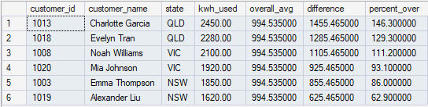
DQL: Customers using more than overall average
SELECT
c.customer_id,
c.customer_name,
c.state,
m.kwh_used,
(SELECT AVG(kwh_used) FROM monthly_usage) AS overall_avg,
m.kwh_used - (SELECT AVG(kwh_used) FROM monthly_usage) AS difference,
ROUND(((m.kwh_used - (SELECT AVG(kwh_used) FROM monthly_usage))
/ (SELECT AVG(kwh_used) FROM monthly_usage)) * 100, 1) AS percent_over
FROM customers c
JOIN monthly_usage m ON c.customer_id = m.customer_id
WHERE m.kwh_used > (SELECT AVG(kwh_used) FROM monthly_usage)
ORDER BY m.kwh_used DESC;

Slide 11
DQL: Customers using more than THEIR STATE average Part 1
SELECT
c.customer_id,
c.customer_name,
c.state,
c.suburb,
m.kwh_used,
-- Correlated subquery: Calculates average FOR THIS ROW'S STATE
(SELECT AVG(m2.kwh_used)
FROM monthly_usage m2
JOIN customers c2 ON m2.customer_id = c2.customer_id
WHERE c2.state = c.state) AS state_average,
-- How much over state average
ROUND(m.kwh_used - (SELECT AVG(m2.kwh_used)
FROM monthly_usage m2
JOIN customers c2 ON m2.customer_id = c2.customer_id
WHERE c2.state = c.state), 2) AS kwh_over_average,

Slide 12
DQL: Customers using more than THEIR STATE average Part 2
-- Percentage over state average
ROUND(((m.kwh_used - (SELECT AVG(m2.kwh_used)
FROM monthly_usage m2
JOIN customers c2 ON m2.customer_id = c2.customer_id
WHERE c2.state = c.state))
/ (SELECT AVG(m2.kwh_used)
FROM monthly_usage m2
JOIN customers c2 ON m2.customer_id = c2.customer_id
WHERE c2.state = c.state)) * 100, 1) AS percent_over_avg
FROM customers c
JOIN monthly_usage m ON c.customer_id = m.customer_id
WHERE m.kwh_used > (SELECT AVG(m2.kwh_used)
FROM monthly_usage m2
JOIN customers c2 ON m2.customer_id = c2.customer_id
WHERE c2.state = c.state)
ORDER BY percent_over_avg DESC;

Slide 13
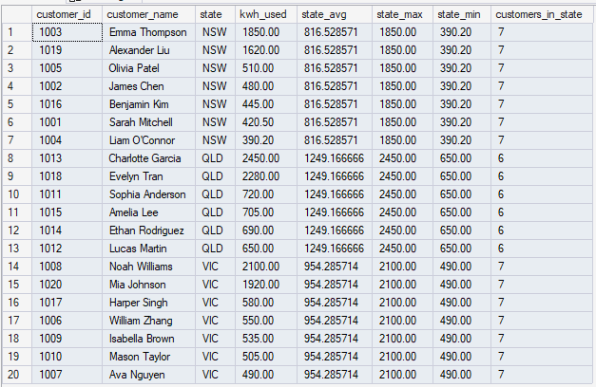
DQL: Showing customer usage vs state avg vs state max
SELECT
c.customer_id,
c.customer_name,
c.state,
m.kwh_used,
-- Subquery in SELECT: State average
(SELECT AVG(m2.kwh_used)
FROM monthly_usage m2
JOIN customers c2 ON m2.customer_id = c2.customer_id
WHERE c2.state = c.state) AS state_avg,
-- Subquery in SELECT: State maximum
(SELECT MAX(m2.kwh_used)
FROM monthly_usage m2
JOIN customers c2 ON m2.customer_id = c2.customer_id
WHERE c2.state = c.state) AS state_max,
-- Subquery in SELECT: State minimum
(SELECT MIN(m2.kwh_used)
FROM monthly_usage m2
JOIN customers c2 ON m2.customer_id = c2.customer_id
WHERE c2.state = c.state) AS state_min,
-- Subquery in SELECT: Customer count in state
(SELECT COUNT(*)
FROM customers c2
WHERE c2.state = c.state) AS customers_in_state
FROM customers c
JOIN monthly_usage m ON c.customer_id = m.customer_id
ORDER BY c.state, m.kwh_used DESC;

Slide 14

DQL: Showing states with average usage > 600 kWh
SELECT
state,
total_customers,
avg_usage_kwh,
max_usage_kwh,
total_revenue
FROM (
-- Inner query: Create state summary (this is the "derived table")
SELECT
c.state,
COUNT(*) AS total_customers,
ROUND(AVG(m.kwh_used), 2) AS avg_usage_kwh,
MAX(m.kwh_used) AS max_usage_kwh,
SUM(m.bill_amount) AS total_revenue
FROM customers c
JOIN monthly_usage m ON c.customer_id = m.customer_id
GROUP BY c.state
) AS state_summary
WHERE avg_usage_kwh > 600 -- Outer query: Filter the summary
ORDER BY avg_usage_kwh DESC;

Slide 15
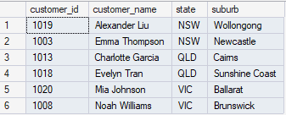
DQL: Find Customers who HAVE high usage (>1500 kWh)
SELECT
c.customer_id,
c.customer_name,
c.state,
c.suburb
FROM customers c
WHERE EXISTS (
SELECT 1
FROM monthly_usage m
WHERE m.customer_id = c.customer_id
AND m.kwh_used > 1500
)
ORDER BY c.state, c.customer_name;

Slide 16

DML and DQL: Find Customers with NO Usage records
-- First, let's add a customer with no usage for demonstration
INSERT INTO customers VALUES
(1099, 'Test Customer', 'NSW', 'Sydney', 'Residential', '2024-01-01');
PRINT 'Added test customer (ID: 1099) with no usage records';
PRINT '';
-- Now find customers with no usage
SELECT
c.customer_id,
c.customer_name,
c.state,
c.signup_date
FROM customers c
WHERE NOT EXISTS (
SELECT 1
FROM monthly_usage m
WHERE m.customer_id = c.customer_id
)
ORDER BY c.customer_id;

Slide 17
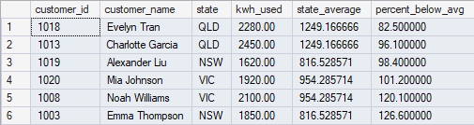
DQL: Find Customers whose usage is BELOW their state average
SELECT
c.customer_id,
c.customer_name,
c.state,
m.kwh_used,
(SELECT AVG(m2.kwh_used)
FROM monthly_usage m2
JOIN customers c2 ON m2.customer_id = c2.customer_id
WHERE c2.state = c.state) AS state_average,
ROUND(((m.kwh_used - (SELECT AVG(m2.kwh_used)
FROM monthly_usage m2
JOIN customers c2 ON m2.customer_id = c2.customer_id
WHERE c2.state = c.state))
/ (SELECT AVG(m2.kwh_used)
FROM monthly_usage m2
JOIN customers c2 ON m2.customer_id = c2.customer_id
WHERE c2.state = c.state)) * 100, 1) AS percent_below_avg
FROM customers c
JOIN monthly_usage m ON c.customer_id = m.customer_id
WHERE m.kwh_used > (SELECT AVG(m2.kwh_used) -- Changed > to <
FROM monthly_usage m2
JOIN customers c2 ON m2.customer_id = c2.customer_id
WHERE c2.state = c.state)
ORDER BY percent_below_avg;

Slide 18
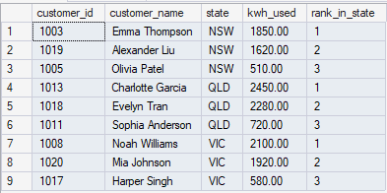
DQL: Find the top 3 highest usage customers in each state
WITH ranked_customers AS (
SELECT
c.customer_id,
c.customer_name,
c.state,
m.kwh_used,
ROW_NUMBER() OVER (PARTITION BY c.state ORDER BY m.kwh_used DESC) AS rank_in_state
FROM customers c
JOIN monthly_usage m ON c.customer_id = m.customer_id
)
SELECT
customer_id,
customer_name,
state,
kwh_used,
rank_in_state
FROM ranked_customers
WHERE rank_in_state <= 3
ORDER BY state, rank_in_state;

Slide 19
DQL: Find Customers who have NO usage records at all
SELECT
c.customer_id,
c.customer_name,
c.state,
c.signup_date,
DATEDIFF(DAY, c.signup_date, GETDATE()) AS days_since_signup
FROM customers c
WHERE NOT EXISTS (
SELECT 1
FROM monthly_usage m
WHERE m.customer_id = c.customer_id
)
ORDER BY c.signup_date; --EXPECT NO OUTPUT

Slide 20

DQL: Create state summary, then filter to average usage (> 600)
SELECT
state,
total_customers,
avg_usage_kwh,
max_usage_kwh,
min_usage_kwh,
total_revenue,
ROUND(total_revenue / total_customers, 2) AS avg_revenue_per_customer
FROM (
SELECT
c.state,
COUNT(*) AS total_customers,
ROUND(AVG(m.kwh_used), 2) AS avg_usage_kwh,
MAX(m.kwh_used) AS max_usage_kwh,
MIN(m.kwh_used) AS min_usage_kwh,
SUM(m.bill_amount) AS total_revenue
FROM customers c
JOIN monthly_usage m ON c.customer_id = m.customer_id
GROUP BY c.state
) AS state_summary
WHERE avg_usage_kwh > 600
ORDER BY avg_usage_kwh DESC;

Slide 21
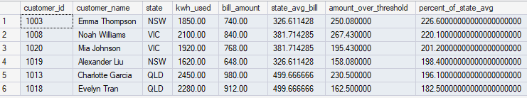
DQL: Find customers whose bill is >150% of their state average bill
-- SOLUTION:
SELECT
c.customer_id,
c.customer_name,
c.state,
m.kwh_used,
m.bill_amount,
-- State average bill
(SELECT AVG(m2.bill_amount)
FROM monthly_usage m2
JOIN customers c2 ON m2.customer_id = c2.customer_id
WHERE c2.state = c.state) AS state_avg_bill,
-- How much over threshold (150% of avg)
ROUND(m.bill_amount - (1.5 * (SELECT AVG(m2.bill_amount)
FROM monthly_usage m2
JOIN customers c2 ON m2.customer_id = c2.customer_id
WHERE c2.state = c.state)), 2) AS amount_over_threshold,
-- Percentage of state average
ROUND((m.bill_amount / (SELECT AVG(m2.bill_amount)
FROM monthly_usage m2
JOIN customers c2 ON m2.customer_id = c2.customer_id
WHERE c2.state = c.state)) * 100, 1) AS percent_of_state_avg
FROM customers c
JOIN monthly_usage m ON c.customer_id = m.customer_id
WHERE m.bill_amount > (1.5 * (SELECT AVG(m2.bill_amount)
FROM monthly_usage m2
JOIN customers c2 ON m2.customer_id = c2.customer_id
WHERE c2.state = c.state))
ORDER BY percent_of_state_avg DESC;

